Slide 1
Visualizing MS Forms Responses in Power BI

Slide 2
Renata Kalsbeek
Marketing Coordinator for Iteration Insights
Power Platform User Group
Calgary Azure Analytics User Group
renata.kalsbeek@iterationinsights.com
https://www.linkedin.com/in/renata-kalsbeek-8b9684111/

Slide 3
Tanya Zheng
Analytics Consultant for Iteration Insights
Power BI, SSMS, Analysis Services, Azure
MCSA BI Reporting
tanya.zheng@iterationinsights.com
https://www.linkedin.com/in/tanya-zheng-44038731/

Slide 4
Agenda
Microsoft Forms
SharePoint
Microsoft Teams
Power BI
Power Automate

Slide 5
Why are we talking about this?
No Microsoft Forms connector in Power BI
Automation saves us time
Power BI allows to manipulate the data as we wish

Slide 6
From Microsoft Forms to SharePoint List

Slide 7
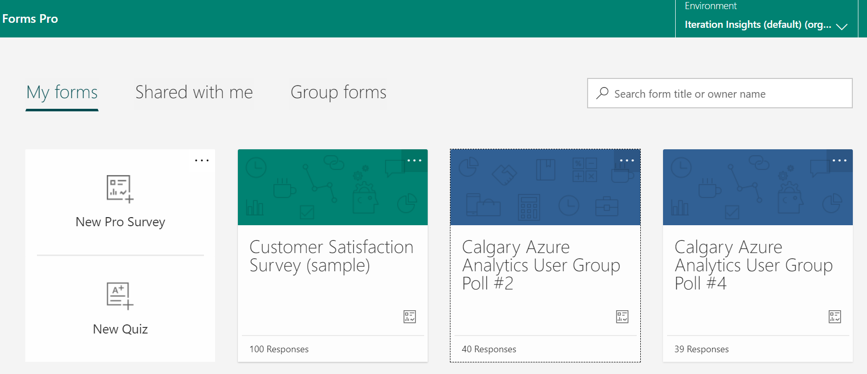
Microsoft Forms
Create your Survey in Microsoft forms
Notes:
The first step is to create your survey in Microsoft Forms.
You can do simple survey with the free version of Forms. For branching conditions and other features you need Forms Pro.

Slide 8
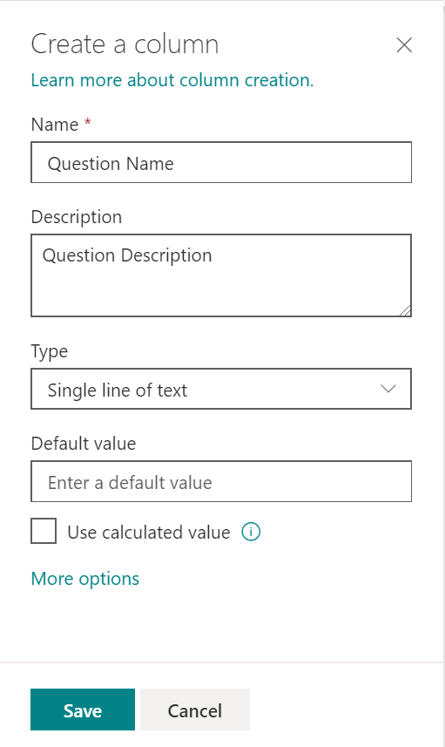
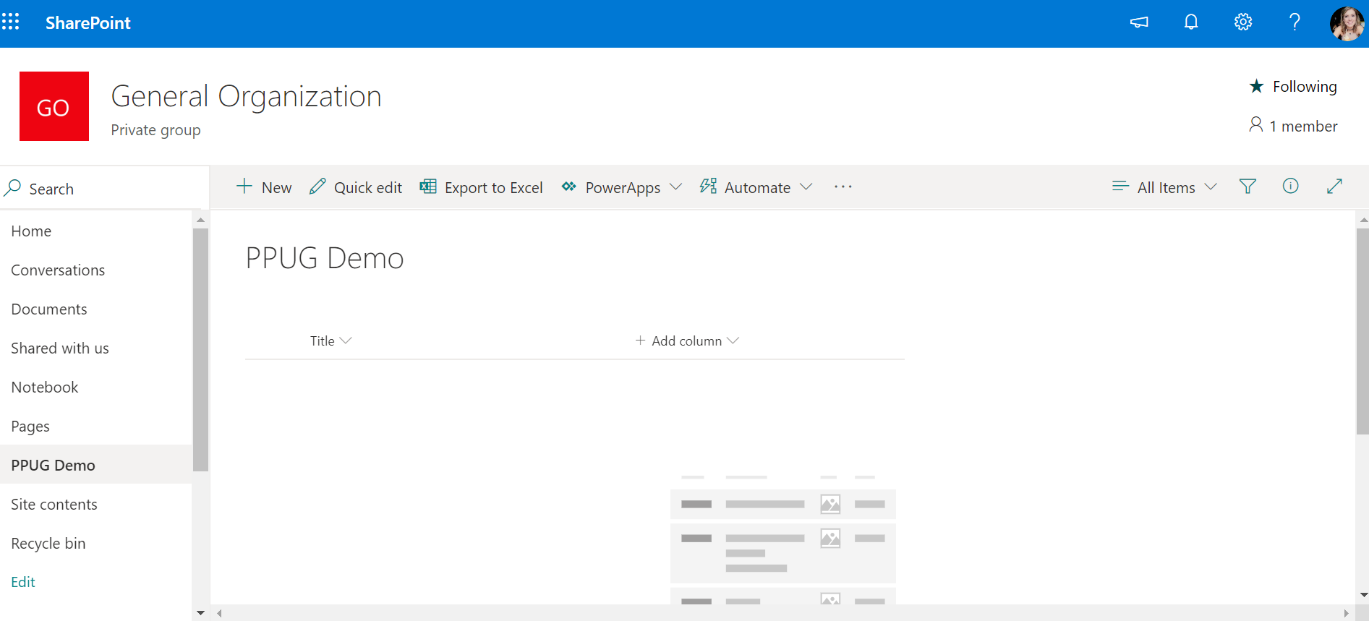
SharePoint List
1
3
2
Notes:
Next, create a SharePoint list that has 1 columns for every question in the survey.
Keep the type as Single Line text. This can be transformed later in Power BI.
If you have a fill in the blank question, use Multiple Line Text to ensure if a responder writes a lot that it will fit into the field.

Slide 9
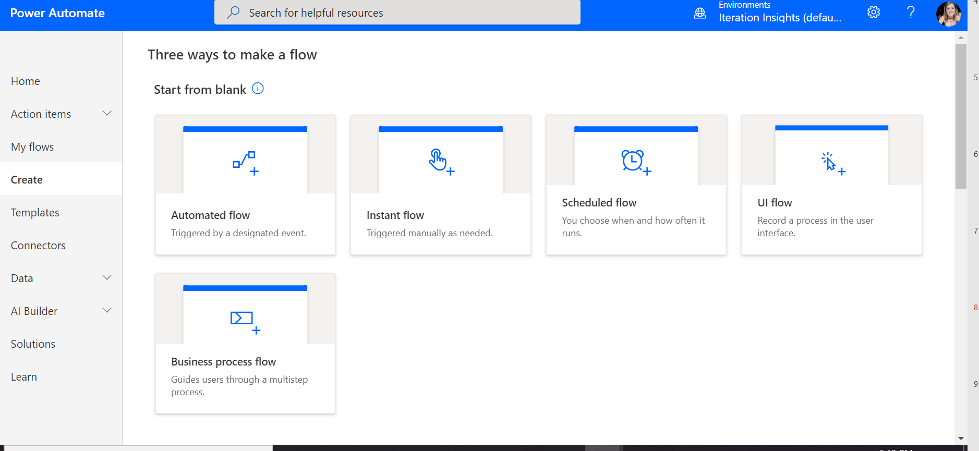
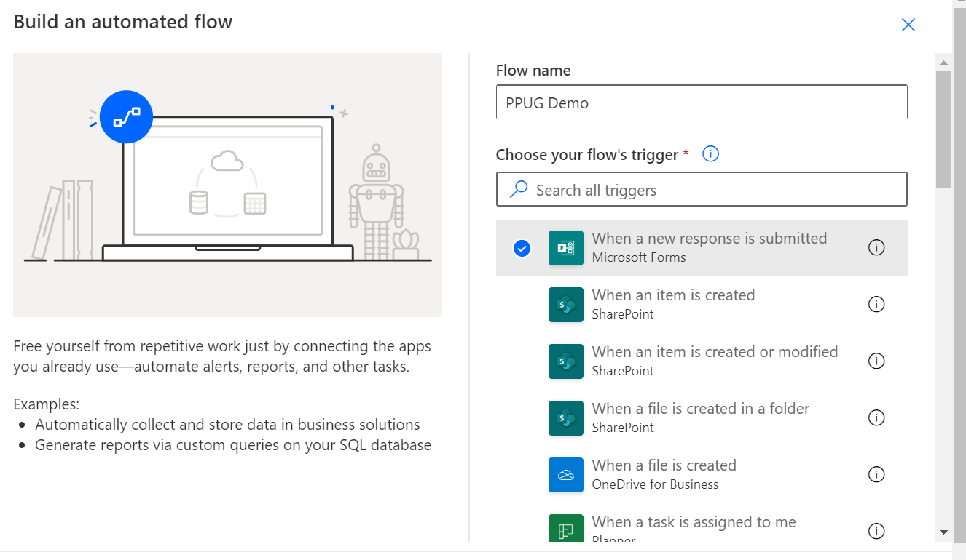
Power Automate
Notes:
We are creating an automate flow. I believe there is a template for this but I don’t care to search for this now that I know how to build it myself.
The trigger is When a new response is submitted.
I believe Forms is a free connector for Power Automate.

Slide 10
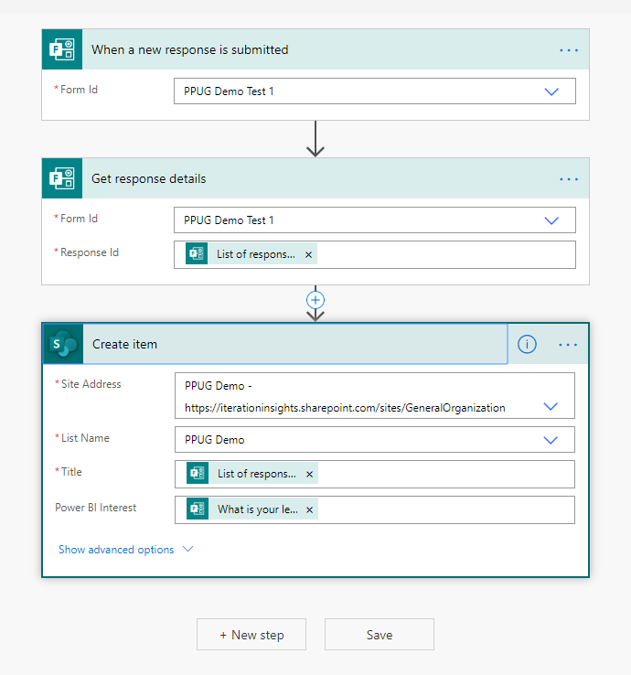
Power Automate

Slide 11
From SharePoint List to Power BI Report

Slide 12
Visualize Survey Response in Power BI
Topic
Getting Data into Power BI
Data Transformation
Calculated Column and Measure
Visualization
Publish and Embed the Report

Slide 13
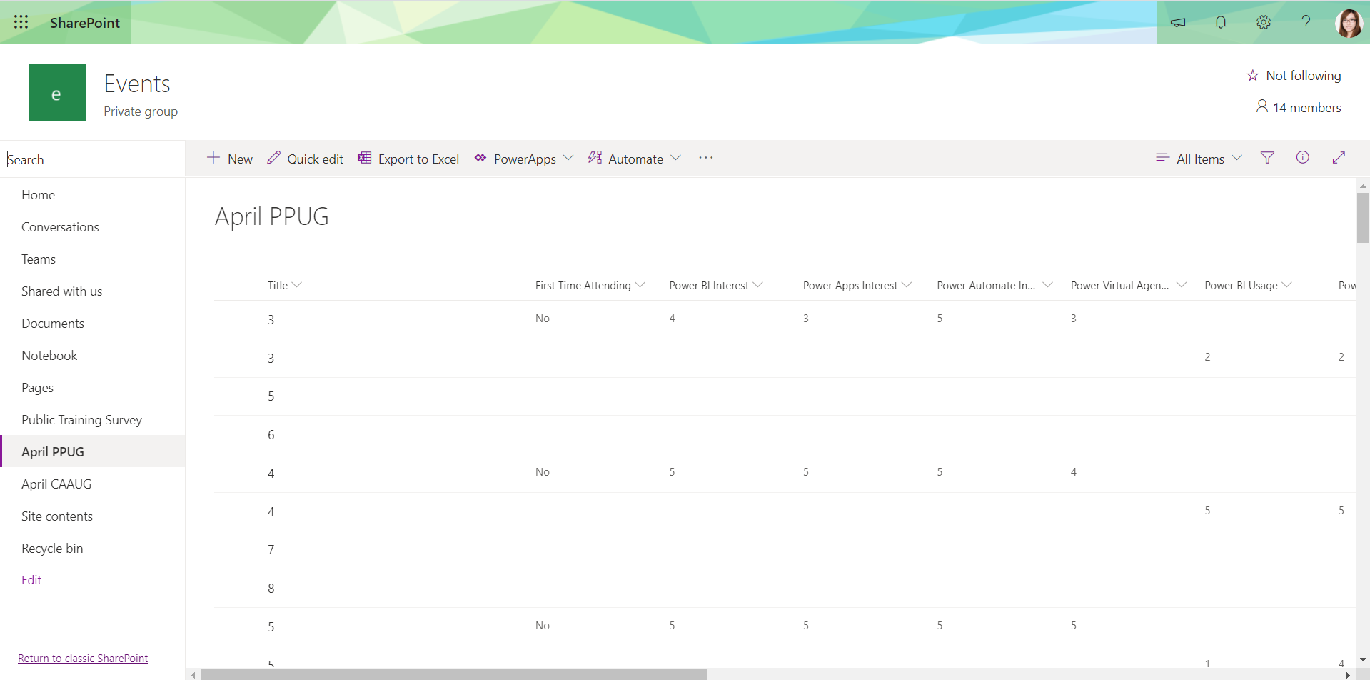
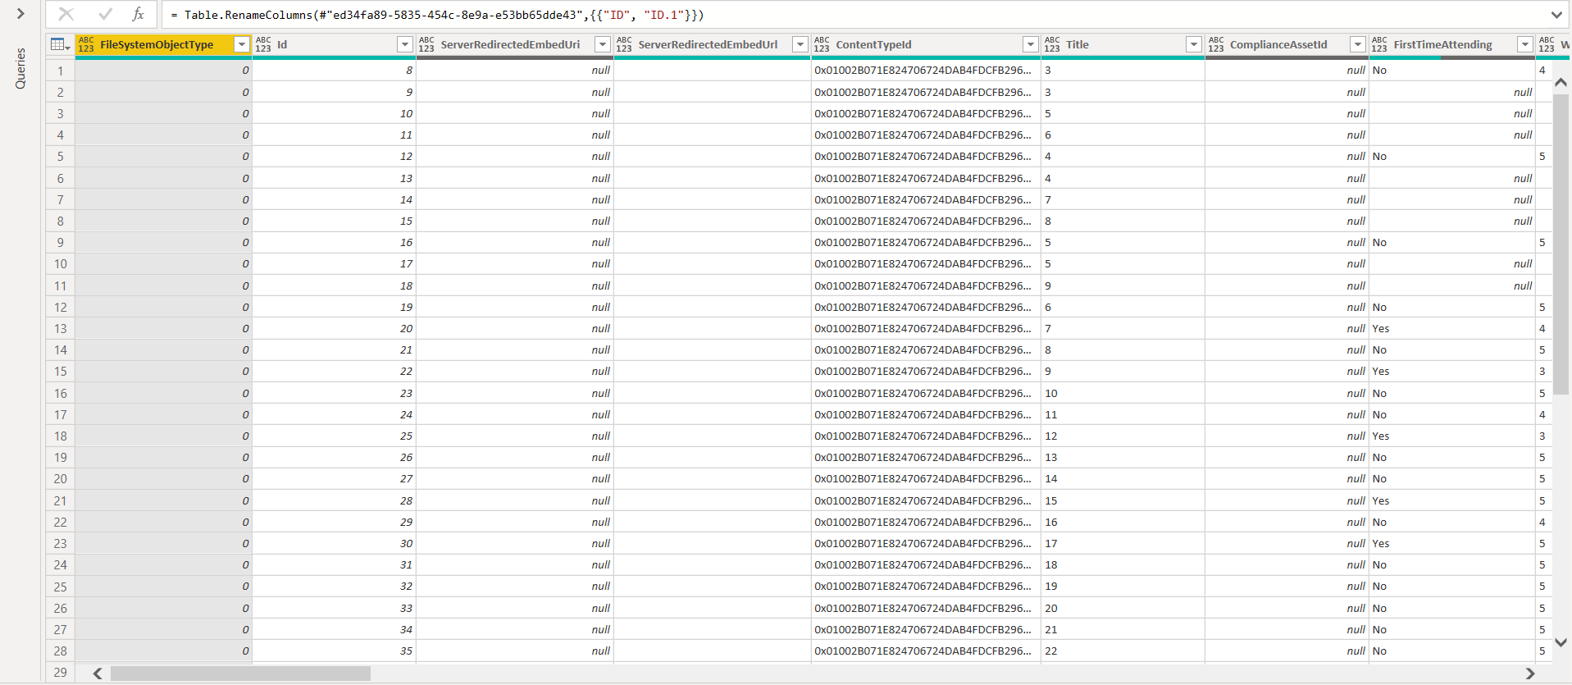
Getting Data into Power BI
SharePoint List
Power BI

Slide 14
Data Transformation
Power Query
FactPPUG, DimRespondent, DimQuestion
Power BI Desktop
DimDate

Slide 15
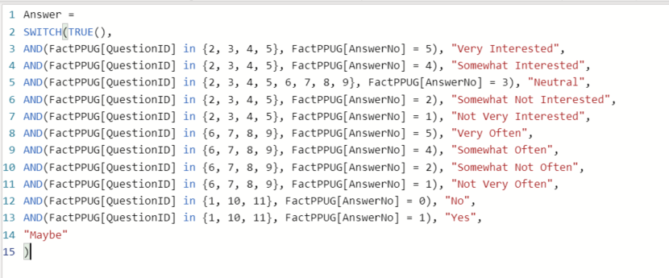
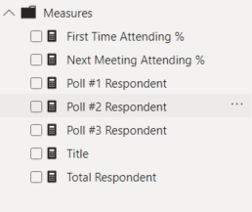
Calculated Column and Measure

Slide 16
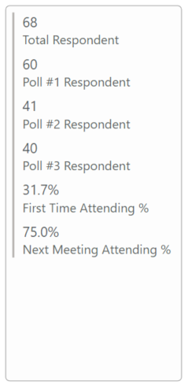
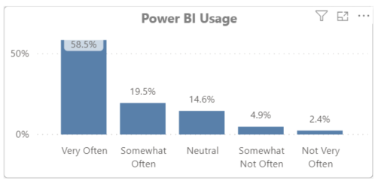
Visualization
Multi-Row Card
Clustered Column Chart

Slide 17
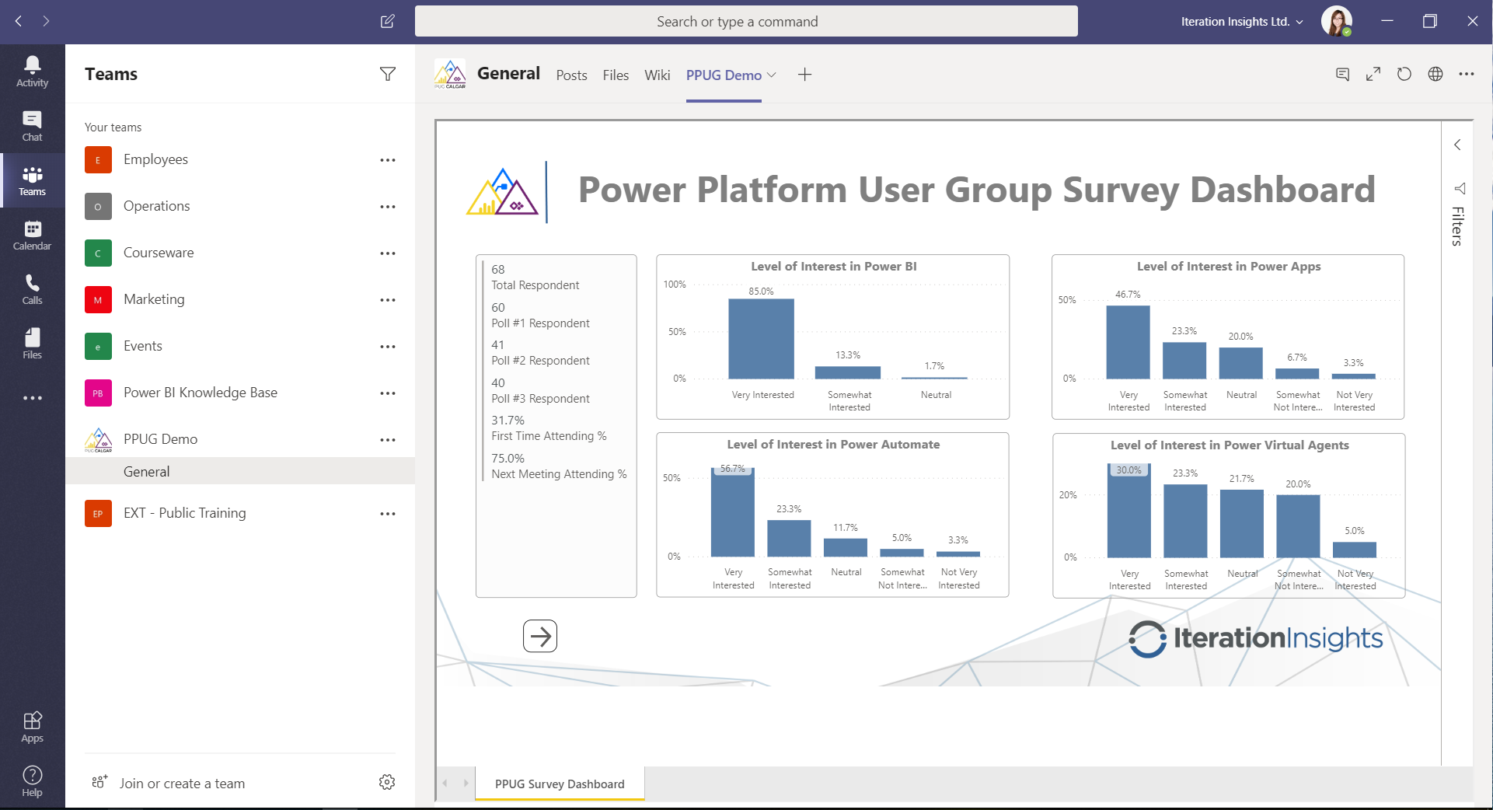
Publish and Embed the Report
Publish to the Service
Embed in MS Teams Channel

Slide 18
Visualize Survey Response in Power BI
Reference
Create a Report on a SharePoint List
https://docs.microsoft.com/en-us/power-bi/desktop-sharepoint-online-list
Star Schema: Still Relevant Almost 30 years Later?
https://iterationinsights.com/star-schema-still-relevant-almost-30-years-later/
Creating a simple date table in DAX
https://www.sqlbi.com/articles/creating-a-simple-date-table-in-dax/
Embed Report with the Power BI tab for MS Teams
https://docs.microsoft.com/en-us/power-bi/service-embed-report-microsoft-teams

Slide 19
Thank you for listening!
QUESTIONS?

